Slide 1

Creating branches

Slide 2

Moving to the branch

Slide 3
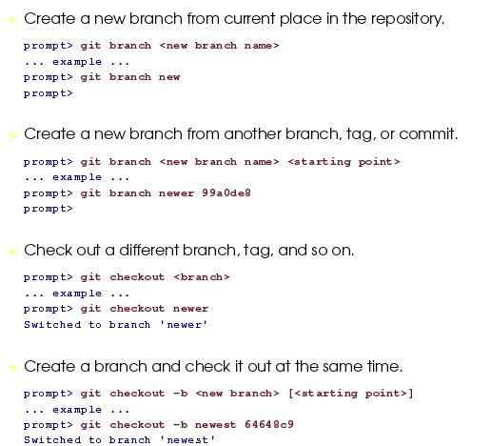

Slide 4
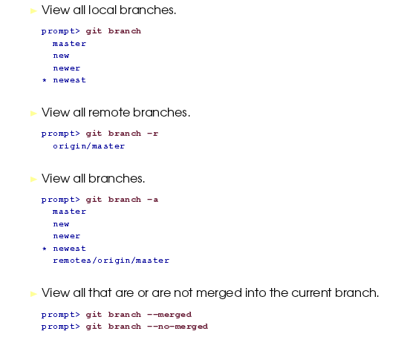
Viewing branches

Slide 5
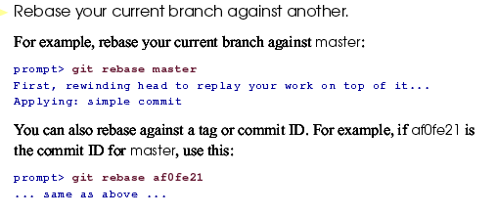

Slide 6

Deleting a branch

